Slide 1
MINI PROJECT-I
Rice Talk: Rice Blast Detection Using Internet of Things and Artificial Intelligence Technologies
Team Members
Lohitha Yalavarthi (002289255)
Nitish Kumar Pilla (002286814)
Bhargav Movva (002292699)

Slide 2
Introduction
Main Topic discussion and the problem
This article mainly focuses on the implementation of Rice Talk Application using IOT and AI Technologies to detect the Rice blast disease
The rice blast disease which is caused by fungus named Magnaporthe oryzae (or Magnaporthe grisea), which results in lesions in leaves, stems, peduncles, panicles , seeds and roots
The rice blast disease causes the overall destruction of rice crop fields due to its spread from one plant to the other which leads to starvation in people
Due to Technological Advancements, we were able to detect lot of plant diseases efficiently which is discussed in below points
The digital plant disease detection was developed based on the deep convolution neural network used to classify three types of diseases and two types of pests for casava leaves with an accuracy of 93%
A multi disease identification Algorithm used to classify the rust, Septoria and tan spot diseases from wheat images

Slide 3
Continuing of Introduction
The approach of Rice Talk using nonimage sensors
A color constancy algorithm used to reduce natural illumination variability effects which resulted 80% accuracy
From the above 5th and 6th and 7th points the algorithms might require manual operations to obtain the photos and data .
These image-based or nonimage hyperspectral-based data approaches for detecting plant diseases which is costly and time consuming (I.e deploying multiple cameras and almost impossible of use of drones in fields )and furthermore the plant diseases might already affect the plants due to lack of early-stage disease detection by cameras.
Based on AgriTalk[4] an IOT platform for soil cultivation ,Rice Talk Application is developed . This Application uses nonimage IOT devices and agriculture sensors and actuators and weather stations. These sensors used in agriculture soil for precision monitoring and the cultivation actuators for irrigation , pest control and fertilization
Unlike the image-based plant disease detection approaches , AgriTalk Sensors generates non image data

Slide 4
Continuing of Introduction
The approach of Rice Talk using nonimage sensors
This application is deployed using IOT combined with AI modelling
This AI model is automatically trained and analyzed the non-image data which is generated by the agriculture sensors and provides the accurate predictions and early detections and reduction of platform management costs
Rice Talk Application uses AI model (I.e., Deeply convolution neural network model) which is treated as an IOT device therefore managed like any other IOT devices (I.e., the actuators and sensors)
This article also focuses on spore germination which is discussed as a feature to machine learning . From the AI point of view This spore germination mechanism is an innovative feature extraction model for agriculture
From overall points above this article discuss the implementation of Rice Talk Projects which is effectively used for the detection of rice blast disease using the non-image data

Slide 5
Background and related work
This is from reference [2] which is comparing four models for predicting early warnings to rice blast disease , two operational process-based models (Yoshino and Water Accounting Rice Model (WARM) and two approaches based on machine learning algorithms (I.e., M5Rules and Recurrent Neural Networks (RNN)) The former inducing a rule-based model and latter building a neural network.
This study is also based on Rice Guard Project which plays major role on collecting the spatially distributed weather data that is used to predict the rice blast disease which will be discussed In further points
Apart from the consideration of Yoshino and WARM model approaches ,there are a new techniques discussed in the below points which is Rice blast prediction using AI and statistical.
In this study one statistical and two machine learning techniques – i.e., multiple regression, neural network and support vector machine – were applied to predict rice blast in different sites and seasons
The data derived from laser-induced chlorophyll fluorescence to predict rice blast.
They first applied principal components analysis (PCA) to reduce the dimensionality of the spectral information, and then derived statistical models using discriminant analysis (DA), multiple logistic regression analysis (MLRA), and multilayer perceptron (MLP) techniques and then reported a prediction of 91.7% using PCA-MLP

Slide 6
Continuing of Background and related work
They have used ANN (Associative neural network) and support vector machine(SVM) binary classifiers for predicting occurrences of rice blast disease'. preprocessed the data using PCA to determine the weather data
Based on this previous studies using ANN and SVM and the above techniques the best performance of predicting rice blast were obtained with SVM , with mean squared error (MSE) and r² being 0.23 and 0.77, respectively, for SVM, and 0.46 and 0.47 for ANN.
This study also includes the RICE-GUARD EU project uses in-situ state-of-the-art data capture metrology equipment to obtain the datasets
The RICE-GUARD EU project aims at capturing in-field telemetry data to improve predictive capability of Yoshino model to that of warm approach
This RICE-GUARD developed the low-cost field WSN( Wireless sensor network) which is used to increase representativeness of weather data used to feed rice blast forecasting systems.
The RICE GUARD WSN is largely based on advances in IOT, Which allows the implementation of wireless networks and radio frequency communications to collect real-time, spatially distributed weather data which is shown in the image (present in the next slide)

Slide 7
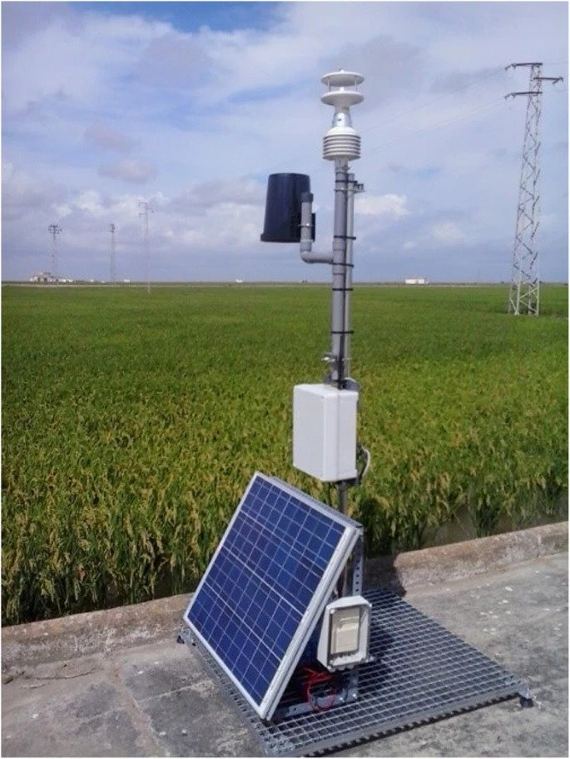
Indeed, although weather data is the main driver of blast models, its reliability is often threatened by the spatial distribution of weather stations, which are often placed outside rice cultivation areas.
The resulting uncertainty that often characterizes existing systems for blast alert leads to a lack of confidence in advisory bulletins and to an overuse of fungicides, resulting in sizable economic and environmental costs.
[3] This RICE-GUARD system is composed by autonomous nodes containing 4 levels of temperature, relative humidity, leaf wetness and solar irradiance sensors, a communications module and an energy harvesting unit made of solar panels; an autonomous master node, equipped with all the sensors commonly found in weather stations
In addition The communication system receiving the readings of all nodes in the area and storing it on a local database while uploading it to the cloud; and a user interface displaying the information coming from the field and applying the rice blast prognosis model[3]
Data capture RICE-GUARD station located outside the paddy field, for gathering and transmitting in real time readings from the in-field sensors

Slide 8
Yoshino and WARM models are based on a fixed model structure and contain parameters that need to be defined by experts using detailed datasets of observations, given that their values could vary across geographic areas and climates
Indeed, within the RICE-GUARD project, a different temperature threshold was used in the Yoshino model to adapt it to the conditions experienced by the pathogen in the Mediterranean climate, because Yoshino was originally developed and tested in Asia
On the other hand, the use of data-driven machine learning algorithms makes it easier to customize the resulting rice blast models to specific areas and climates. These Process-based and data-driven models can be used to provide early warnings to anticipate rice blast and detect its presence
Based on reference [3] RICE-GUARD was validated in 5 rice cultivation areas in Europe and proved to provide valuable information to all of them. It was installed in rice paddies under controlled and non-controlled conditions in order to prove the adaptability of the model. This allowed to effectively develop a model that was easily adaptable to all areas and which was demonstrated to predict the risk conditions in which the crops where infected.
From the above points we can define the obtaining quality in-field data in RICE-GUARD PROJECT which can be obtained in the different climates and geographical areas and that can be fed to the models Among the process-based models, the Yoshino approach achieved better performances to predict rice blast that were slightly better than the WARM one, although WARM was fed using 2 km × 2 km gridded weather data, whereas Yoshino used the weather data collected using the in-field wireless sensor network developed within the RICE-GUARD project

Slide 9
Analysis of proposed idea
In this application we use the temperature , the relative humidity and the barometric pressure sensors.
Additionally, to the training data, the experienced farmers can also send the result value(whether there is a chance of infection or not) to the weather input device.
Agritalk server has two components AgriTalk Engine and Agritalk GUI.
For the Agritalk engine, two cyber devices are connected where Data Bank cyber device preprocess the data received from Weather input device, and the ML_device executes the AI model to produce the prediction results which are sent to the Alert device.
In this application we have collected raw data of a sensor in 2738 observation days.
For the training phase we initially pass the training data, that we have collected from 5276 samples in 158 location.
In our system if more than 0% of the area is infected , then the sampling of the area is infected.
And in the survey conducted, rice blast has occurred in 17.4 days per location, and there are 2747 rice blast events among those 5267 samples.
In our experiment N=24 and from every observation day we extract the measures from the dataset like minimum measure(x_{m,s,i}), maximum measure (x_{M,s,i}), accumulated amount measure of rainfall (x_{a,R,i}) etc.
For any measure space
x_{I}={x_{S,I}/s⊂S} , where s⊂{B<T<H<S}

Slide 10
Continuation
Spore Germination function is used to obtain the spore germination rate by using its function.
The ideal temperature for fungal sporulation on seed lession is around 20°c to 32°c and the maximum germination was observed in free water and decreased at lower relative humidity.
Conidia germinated over a wider range of relative humidity (92%-100%).
Therefore, in Spore Germination function we consider the temperature and relative humidity as the two important meteorological factors that affects spore germination rate.
The Spore Germination rate F_{T}(z) based on temperature is
F_{T}(Z)= aTz³+bTz²+cTz+d
The Spore Germination rate F_{H}(z) based on relative humidity is
F_{H}(Z)= a_{H} *exp(b_{Hz}).
By conducting biological experiments on the spores with temperature and humidity values we get the coefficients of the above equation through curve fitting.

Slide 11
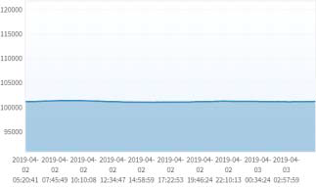
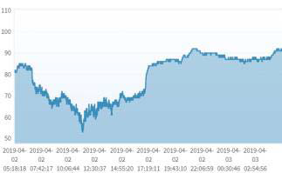
Continuation
For temperature e_{T,i,n} ⊂ E_{T,i} and relative humidity e_{H,i,n} ⊂ E_{H,i}
f_{T}(e_{T,i,n})= -0.0007e³_{T,i,n}+0.2806e²_{T,i,n}+1.66665e_{T,i,n}+0.27 -(1)
f_{H}(z_{H,i,n})= 0.1143* exp(6.6027e_{H,i,n}). -(2)
from (1),(2) ---> ∴f_{G}(e_{T,i,n},e_{H,i,n})= f_{T}(e_{T,i,n})*f_{H}(e_{H,i,n})
By using this function, we can obtain the spore germination rate.
BARP-I HUMIDITY-I

Slide 12
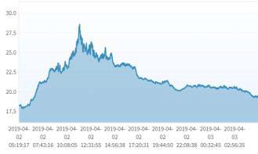
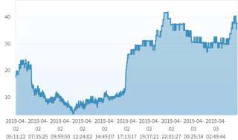
Continuation
temp-I Spore-I
The above the graph represents the time series for temperature , barp-I ,spore-I and humidity-I where the fluctuations of temperature and humidity effects the spike in Spore germination
For high temperature (23°C) and relative humidity (97%) the spore germination rate obtained from measurements was around 92%.
At low temperature (e.g 13°C) and relative humidity (80%), the spore germination rate obtained was 5.41%.
The prediction results for both the values are 86.4% and 6.84%.
This spore germinated is implemented in Rice Talk application by joint connection.
Thus, we can use this spore germination function along with Ai model to predict the rice blast occurrence.

Slide 13
Modelling our Data
We have different AI models like SVM, random forests but CNN Best fits for the rice blast detection dataset because this can perfectly model the change of weather in the life cycle over a period of time .
The real time or historical data is sent to ML_device for execution
let p(x*_{i}) be the probability that rice blast occurs in the ith day and p(x*i) be the probability that rice blast does not occur in the i^{th} day.
Consider x*_{i} as 5 measures in 14 days and pass those measures to the first convolutional layer,
This layer filters the input features with 256 kernels of size 5*1.
The max-pooling layer is used to filter some noises, which returns maximum values.
Here the weather features that cause infection does not change over a short period of time, So for that reason we consider only change in weather features rather than normal weather features.
Each layer has 128 neurons and resulting vector of size 128 is sent to output layer
Here we use "dropout" in CNN model so that overfitting is avoided when working on small training set by thinning the network during training.
In this way, more robust models will be learned in conjunction with many different random subsets of neurons.
Finally, the output layer has two neurons representing how negative and how positive of the results.
The classified result is compared with the results to produce the accurate probabilities P(x*_{i}) and P(x*_{i}).
For validation we use K-fold method for cross validation where k=3 .

Slide 14
Effects of Sensor Measures
We have weather data from 158 location in 14 counties in taiwan. Let C be the set of counties Where C={Taoyuan,Hsinchu,Miaoli,Taichung,Changhua,Yunlin,Chiayi,Tainan,Kaohsiung,Pingtung,Taitung, Hualien, Yilan, Nantou}.
For I=14 days we have best prediction that were made in Miaoli with 100% accuracies for all its predictions.
When we investigate the impact of every measure x_{z,s,I} ∈ x_{s,I} for s ∈ S and the improvements of above probabilities for every measure is defined as
𝑣P(z, s) = P_{φ} − P_{z,s}/P_{z,s}
𝑣P(z, s) = P_{φ} − P_{z,s}/ P_{z,s}
The average measure for the temperature improves the accuracy of positive prediction where max/min measures and range measure has negative impact for prediction.
Coming to Humidity, average measure has a negative impact on net prediction. Whereas max/min measure has significant impact on improving the accuracy of net prediction.
The effect of barometric pressure is not reliable for net prediction ,whereas rain measure has also less significant effect because this measure is already indicated in humidity measure.
Hence Temperature and relative humidity plays a crucial role in predicting the rice blast occurrence and Spore-I measure improves the accuracy of positive prediction.

Slide 15
Advantages
The main advantage of using this rice blast application is ,it doesn't make use of image data as the extraction of real time image data is cost effective and time consuming which is nearly impossible.
By treating IOT model as the AI model, it reduces the platform management cost to provide real time training and predictions.
Data can be easily processed on the real time for an AI Application and our application allows seamless inclusion of machine learning capabilities to the existing IOT applications without much programming effort.
Compared to all the other models CNN gets the most accurate results (89.4%), So there will be more true positive predictions which further significantly reduces the rice blast occurrence by alerting the farmers at any time.
Rice blast UI Project has the simple interface and user friendly which can be easily understood by the farmers, by which actions to the class labelling can be implemented quickly.
Agritalk can easily respond to quick and dynamic change of the field environment conditions in soil cultivation and robust in nature.
By implementing Ml_device as iot device it can utilize various Ai tools that can be executed on powerful machines that are automatically connected to AgriTalk servers..
The output predictions of the infections can be clearly accessed by the end user using the smartphone which doesn’t require much effort.
Inclusion of Spore Germination function in Rice Talk with joint mechanism is an added advantage to this model.

Slide 16
Advantages (continuation)
From the above points we can clearly state that author in this article had suggested that the methods he introduced are better than existing ones (I.e., image analysis in the same research field)​
He also mentioned a way which can provide a cure before spreading rice blast which is of best​
He showcased that his research is better by comparing his results with other models and stated that how his research can resolve the cost issues than with other models

Slide 17
Shortcomings of Rice last application
Accuracy is always a major concern to any AI algorithm.
Rice is major crop in many countries and technology isn't much used in those countries, so this beats the basic purpose when it can't reach major audience
The model can achieve the accuracy to the most but not to the fullest.
Know How of experienced farmers must be crucial, as the system cannot always predict accurate predictions.
The farmers who are working on the field for years already know how to predict and avoid rice blast there won't be any requirement of predicting rice blast using technology
The input data which is to be passed to the model algorithm may not be always true, which further mislead the farmers for their Rice Blast detection.

Slide 18
Shortcomings (continuation)
Some of the factors that determine the development of Rice Blast are the resistance of host plants, length of dew period(period of leaf surface wetness), amount of nitrogen in fertilizers and the abundance of conidia.
Considering the accuracy and other factors involving ,we can effectively manage the rice blast by using appropriate fertilizers like the application of porous hydrated calcium silicate for rice plant is effective in increasing rice blast resistance because it increases the number of silified bulliform cells[5]
In this application we work on with limited labeled data that is used in training phase, so we cannot exactly identify its characteristics for labelling large volumes of data.
In agriculture there are different landforms. So, it becomes difficult to adapt to those changes, and this also jeopardizes data and services. This alters the accuracy of a system.

Slide 19
Conclusion
Rice Talk application uses non image data for predicting the rice blast occurrence rather than traditional image classification algorithms
It uses sensors to get the real time non image data that is used for input to AI model.
This application integrates AI into IOT platform, so that AI model can be managed like other IOT devices.
Spore Germination function is implemented in rice talk application by using joint connection mechanism.
Weather changes also plays a crucial role affecting the spore germination.
The sporulation potential is higher at 20 c and when relative humidity is greater than 89% ,then mature lessions have high rate of humidity.
CNN model is used for rice blast detection dataset as it can effectively model the change in weather.
The prediction accuracies are affected by both sensor measures and hyper parameters of the CNN model
The effects of rain and barometric pressure has no impact on spore germination. Barometric pressure is stable at one location, so it will be difficult to observe its impact.
Generally, spore germination happens for every 14 days period. So, it is better to gather weather data for 14-15 days period.

Slide 20
Conclusion (continuation)
Finally, from those points above, this article had solved lot of problems that image classifications algorithms had it, but this may not be the best there are many shortcoming to this methods than advantages
A great solution would be solving all the problems which farmers are facing and at least outweigh the shortcomings
There are solutions which experienced farmers are doing to avoid the rice blast without using technology hence this might not be great
But the ideas that is being introduced in this article are great and appreciable since it could lead to more possibilities to solve the problems in agriculture field. but the article have not focused on the other factors like cost and awareness and time needed for farmers. but would be better if this initiative is taken by government to help farmers

Slide 21
References
[1] Rice Talk: Rice Blast Detection Using Internet of Things and Artificial Intelligence Technologies
[2] David F. Nettleon, Dimitrios Katsantonis, Argyris Kalaitzidis, Natasa Sarafijanovic-Djukic, Pau Puigdollers and Roberto Confalonien – Predicting Rice Blast disease: machine learning versus processed based models
[3] :In-field wireless sensor network to predict rice blast by Mr. Pau Puigdollers
[4] W.-L. Chen et al., “AgriTalk: IoT for precision soil farming of turmeric cultivation,” IEEE Internet Things J., vol. 6, no. 3, pp. 5209–5223, Jun. 2019
[5] Masahiko Saigusa ,Akiko Yamamoto, Kyoichi Shibuya -"Agricultural Use of Porous Hydrated Calcium Silicate. Effect of porous hydrated calcium silicate on resistance of rice plant (Oryza sativa L.) to rice blast (Pyricularia olyzae)", ISSN: 1343-943X, January 2000

